Slide 1
PyFamilyTree
Phase 1

Slide 2
Agenda
Introduction
Purpose and Scope
Definitions
Overview
Overall Product Description
Specific Requirements
Questions

Slide 3
Purpose and Scope
Product Scope:
A web-application Family Tree app, designed to document & share family information. The goal of this solution is to enable families learn about themselves, their ancestors and living relatives.
Presentation Purpose:
Fully and accurately outline the functional and non-functional requirement of the PyFamilyTree application. This is intended to provide a comprehensive exploration of the application’s features, constraints, assumptions and dependencies for stakeholders.
Intended Audience:
All PyFamilyTree Stakeholders (Development team & customers)

Slide 4
Definitions
Super Administrator (Super Admin)
A user with complete privileges across all components of the application. Assigns administrators to manage specific family trees.
Administrator (Admin)
A user with full privileges within a particular family tree.
Member
A user of the family tree app who has been approved by the admin, and can access the appropriate features for a particular family tree
Direct Relationship
A relationship between two individuals that can be traced via a direct lineage (i.e. parent-child)
Indirect Relationship
A relationship between two individuals that is not a direct lineage (i.e. cousins).
Ancestor/ Descendant
A person from/ to whom a member is descended. An ancensor/descendant’s degree refers to the number of generations between them.

Slide 5
Overview
PyFamilyTree is a web application that allows users to organize and share family tree data and content.
The application’s backend is built using Python, Django, and PostgreSQL, while its frontend is built using Bootstrap, Javascript, HTML, and CSS. External content storage will be provided through Google Drive.
The purpose of this software requirements specification presentation is to provide an overview of the application’s requirements, including both functional and non-functional specifications. It is intended for all project stakeholders, including potential clients and the development team.
This presentation will provide a detailed description of the product scope, functionality, design and implementation constraints, underlying assumptions, and non-functional requirements, as well as detailed schematics regarding database design, user stories, use cases, and activity diagrams.

Slide 6
Overall Product Description
Design and Implementation Constraints
Underlying Assumptions
Dependencies

Slide 7
Product Perspective
PyFamilyTree is an Open Source Project designed to provide a convenient and accessible way to organize family data and content. The application will be a one-stop-shop for accessing and sharing family information. High-level member information and family relationships will be stored in a Postgres database, which will point to the family-specific content store on Google drive.
PyFamilyTree’s main goal is to provide a user-friendly and intuitive platform for managing family information and content. The application’s functionality will be focused on organizing family trees, managing family member information, and storing family content securely. The application’s security measures will ensure that member data is kept confidential, and will be accessible only by the specific family’s administrator and other credentialed users.
PyFamilyTree will allow users to modify relationships, search for family members, and store documents and multimedia files in cloud-based storage. The application will support various types of content including documents (.docx, .pdf), images (.png, .jpeg), video (.mp4), and audio (.mp3, .wav) files. The app will be compatible with all modern web browsers.

Slide 8
User Characteristics
The PyFamilyTree web app is designed with a diverse set of users in mind. Prospective users would be interested in exploring their family history and creating a visual representation of their family tree. The application is designed to be intuitive and easy-to-use, including for members without much technological proficiency or experience with genealogy research. That said, some novices may require some guidance to make full use of the app’s features, and should review the demo videos highlighting the app’s key functionality. Other users could be experienced researchers familiar with genealogy research, for whom interacting with a family tree app should be fairly intuitive.
Since the PyFamilyTree web app will handle sensitive personal data (including dates of birth, marriage, and death, as well as additional private information), users of the application should be aware of the importance of data privacy and security, and refrain from sharing sensitive information with third parties. The application will include measures to protect user privacy and prevent unauthorized data access, through password protection and data encryption.

Slide 9
Design and Implementation Constraints
PyFamilyTree is a family tree application with certain limitations:
Compatibility issues can arise when integrating different technologies or databases for all applications.
Limitations like budget constraints, scalability limitations, time constraints, user-oriented and development-based technical limitations can affect the application's suboptimal performance.
Compliance with regulatory requirements regarding data privacy and user protection can also limit the development options.
There may be variations in user requirements, which can affect the desired features of the application.
Technical limitations of the front-end can restrict the design choices and limit the intuitiveness and user-friendliness of the app.

Slide 10
Underlying Assumptions
Assumptions are an integral part of the development of the PyFamilyTree application:
Control assumptions, environment assumptions, data assumptions, usage assumptions, convention assumptions, user language assumption, and feature independence assumption affect the application's flow.
The application relies on specific database management systems and a well-defined schema to store data.
It has dependencies on Python interpreter and site package versions, Bootstrap/JavaScript versions, and installed packages. The application expects users to interact with it to trace their family lineage and create a visual representation of their family tree, and the user behavior is defined by the application's terms of service

Slide 11
Dependencies
The PyFamilyTree application has dependencies in the following areas:
Database management system and schema
Operating system (OSX and Linux)
Web framework (Django)
Third-party libraries (Python & JavaScript)
APIs for internal and external integration
These dependencies will provide core functionality such as data visualization, authentication, and efficient querying. The development team will release periodic updates to ensure compatibility with the latest operating system updates. Additionally, internal APIs will be thoroughly tested for reliability.

Slide 12
Dependencies
Database Dependencies - The application relies on a specific database management system and a well-defined schema to store and retrieve family tree data. Indexing and additional optimization techniques will be utilized to ensure efficient querying.
Operating System Dependencies - The application is designed to run on the OSX and Ubuntu operating systems. The development team will release periodic updates to ensure compatibility with operating system updates. Attempting to run a local server using other operating systems is not supported by the development team.
Web Framework Dependencies - The application is web-based; so it will require a compatible web framework for the server to run. Django has been selected as the default web development framework.
Library Dependencies - The application’s functionality depends on numerous third-party libraries, especially in the Python & JavaScript programming languages. These libraries will provide core functionality, such as data visualization and authentication. The usage of these libraries will be carefully tested to ensure correct compatibility.
API Dependencies - The application will support both internal and external API (Application Programming Interface) integrations, for both internal communication and interaction with additional services. Internal APIs will be thoroughly tested to ensure reliability.

Slide 13
Specific Requirements
Database Schema
Non-Functional Requirements
Product Functions & System Use Case
Activity Diagrams

Slide 14
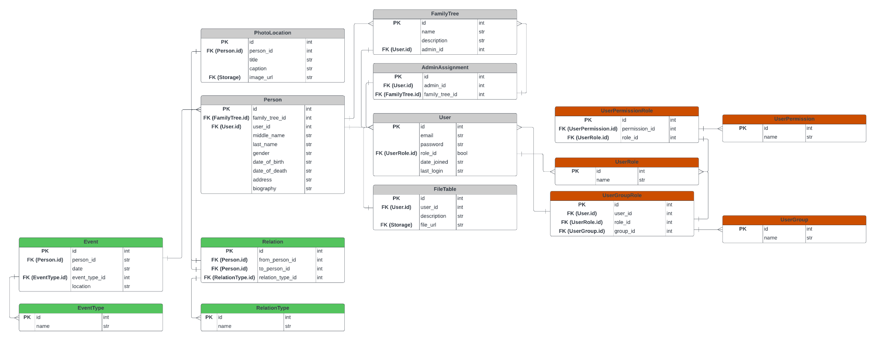
Database Schema

Slide 15
Non-Functional Requirements
Performance Requirements - The application must perform under high traffic conditions, and is designed to handle a large number of family trees, members, and their requests and queries. Load balancing, caching, and software optimization will be performed to ensure that the app can handle traffic without slowdown or timeout issues. Code and service test profiling and paging would ensure compliance of these performance requirements.
Safety and Security Requirements - PyFamilyTree is designed with security in mind, with a focus on preventing unauthorized access to private user data. This is performed via authentication and authorization mechanisms to ensure only authorized users can access the app, and unique family tree data. Member data will be kept confidential and is not to be shared with any unauthorized third parties. To ensure the security of member data, measures such as data encryption, secure storage of sensitive data, and secure communication protocols between app components will be taken.
Usability Requirements - The application is designed to be user-friendly and intuitive for all users. The user interface is designed to be straightforward to navigate, with clear and simple instructions. Moreover, a simple introductory video will be published shortly following the launch of the first version of the app. Thereafter, the application would be appropriate for users of varying levels of technical proficiency. User testing & surveying will ensure effective usability per this requirement.

Slide 16
Non-Functional Requirements
Software Quality Attributes - PyFamilyTree will be reliable, scalable, and maintainable, and software decisions have been made to support that aim. Moreover, the app is designed to be easy to maintain and update via periodic patches. To that end, the code will be well-documented and will adhere to established coding standards - PEP8 for the Python backend and JSLint for the JS frontend. The app is also designed to be scalable and to accommodate new features. Underwriting software quality will be a Pytest-based test suite which will be developed alongside the software in a Test-Driven Development methodology, ensuring that the application will be of high quality and the standard defined.
Maintainability Requirement - PyFamilyTree is designed with maintainability in mind, as new features and updates are planned to be released in the future. To ensure that the app will remain easy to maintain and update, the code will be well-organized and well-documented, with clear naming conventions and comments. Software modularity will be employed in development, allowing for modular updates without affecting the rest of the codebase. PyFamilyTree will undergo regular testing, including unit testing whenever a new build is pushed, to ensure that new code won’t negatively impact the existing code. Following the first launch, the development team will release a detailed user manual to help future developers understand the underlying code and architecture.

Slide 17
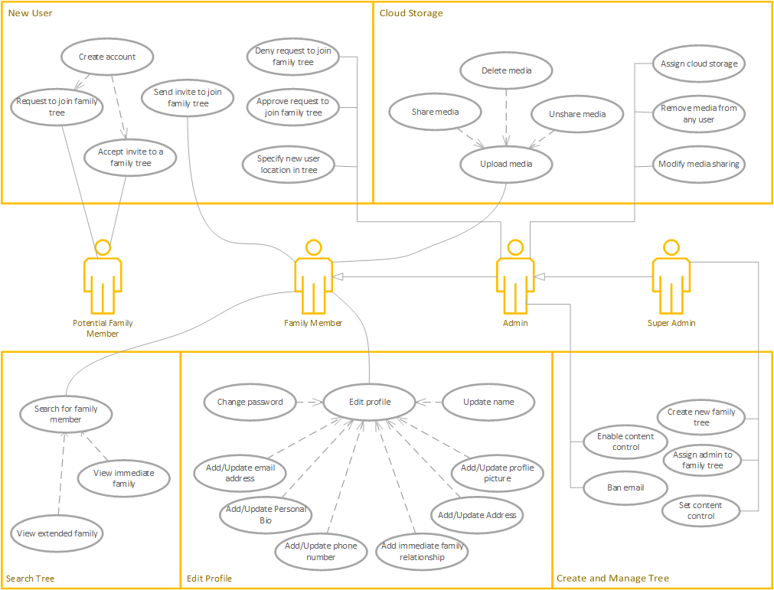
Product Functions / Use Cases

Slide 18
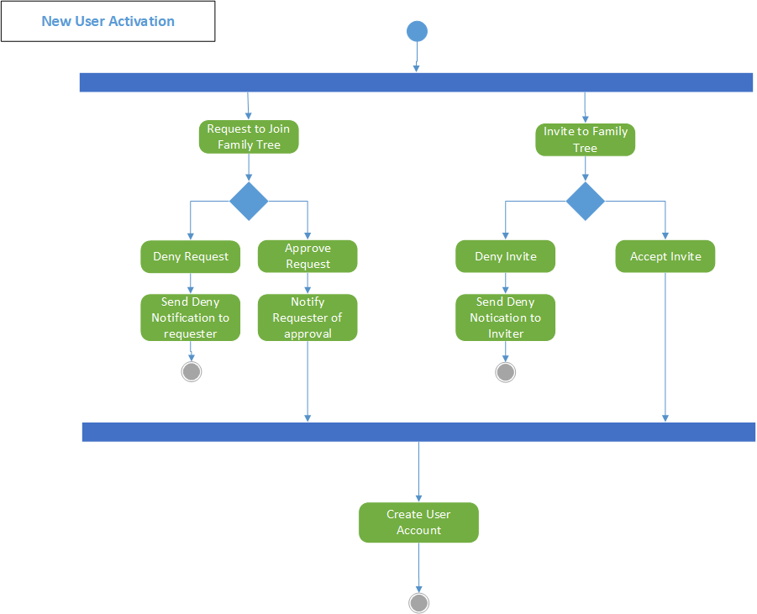
Activity Diagrams

Slide 19
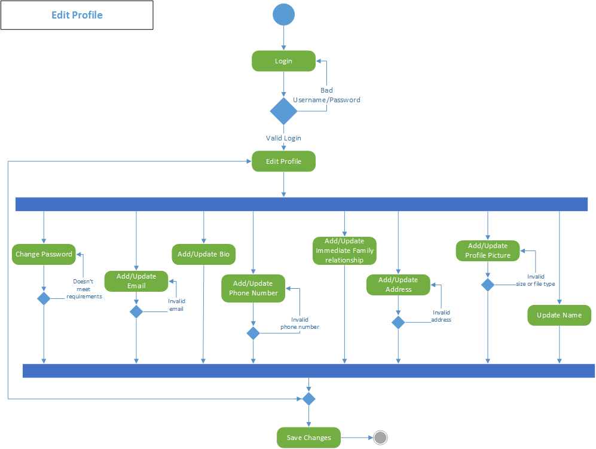
Activity Diagrams

Slide 20
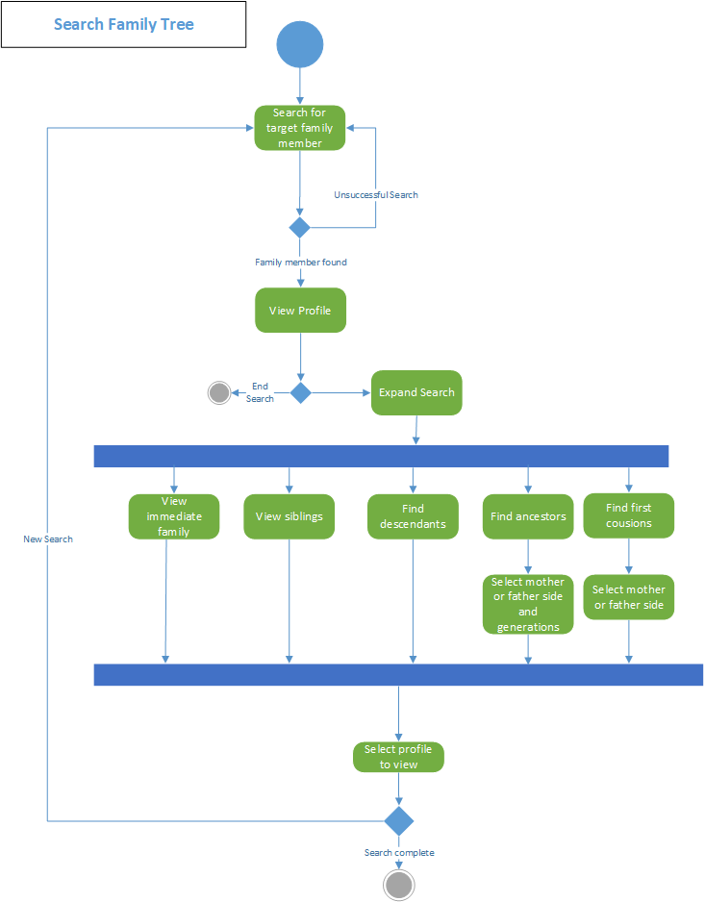
Activity Diagrams

Slide 21
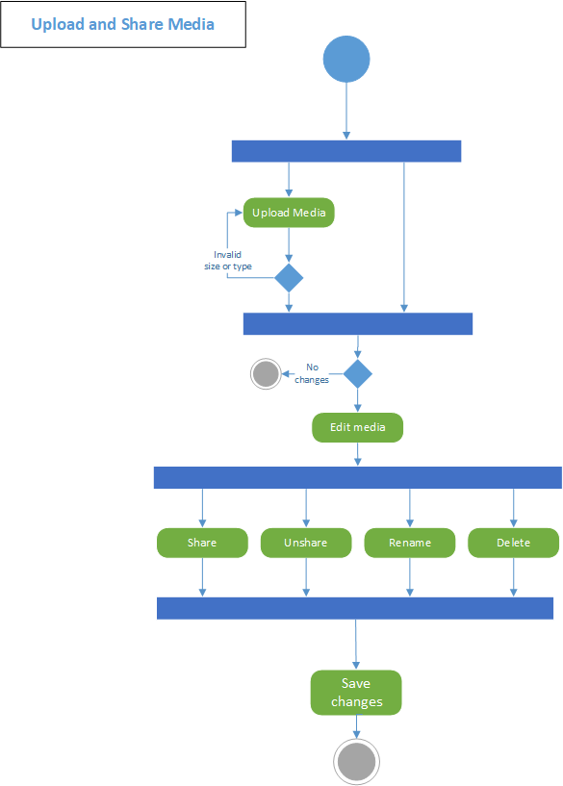
Activity Diagrams

Slide 22
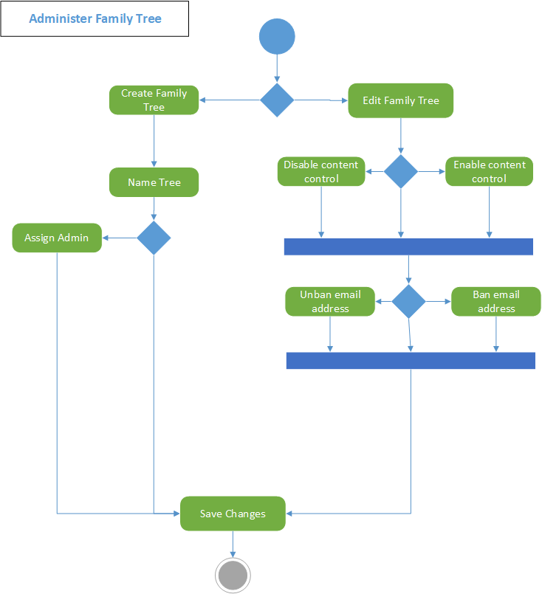
Activity Diagrams

Slide 23
Conclusion
Product Scope
Development tools
User Characteristics
Constraints, Assumptions & Dependencies
Database Schema
Functional and Non-Functional Requirements
Notes:
A web-application Family Tree app, designed to document & share family information.
The application’s backend is built using Python, Django, and PostgreSQL, while its frontend is built using Bootstrap, Javascript, HTML, and CSS. External content storage will be provided through Google Drive.

Slide 24
References
PostgreSQL documentation: https://www.postgresql.org/docs/ - The official documentation for PostgreSQL, the database management system used in the application.
Django documentation: https://docs.djangoproject.com/en/3.2/ - The official documentation for Django, the chosen web platform for the application.
Python documentation: https://docs.python.org/3/ - The official documentation for the Python programming language, which is the key programming language in the backend implementation.
JavaScript documentation: https://javascript.info/ - The official documentation for JavaScript, the key programming language in the front-end of the application.
CSS documentation: https://devdocs.io/css/ - The official documentation for CSS, the stylesheet language used for our HTML documents.
HTML documentation: https://html.spec.whatwg.org/multipage/ - The official documentation for HTML, the Markup language used in the frontend’s design.
Lucidchart documentation: https://www.lucidchart.com - A diagramming and visual communication tool used in the design and planning of the database structure.
Visio documentation: https://support.microsoft.com/en-us/visio - A diagramming and vector graphics application used in the design and planning of use cases, and activity diagrams.

Slide 25
Questions?

